Slide 1
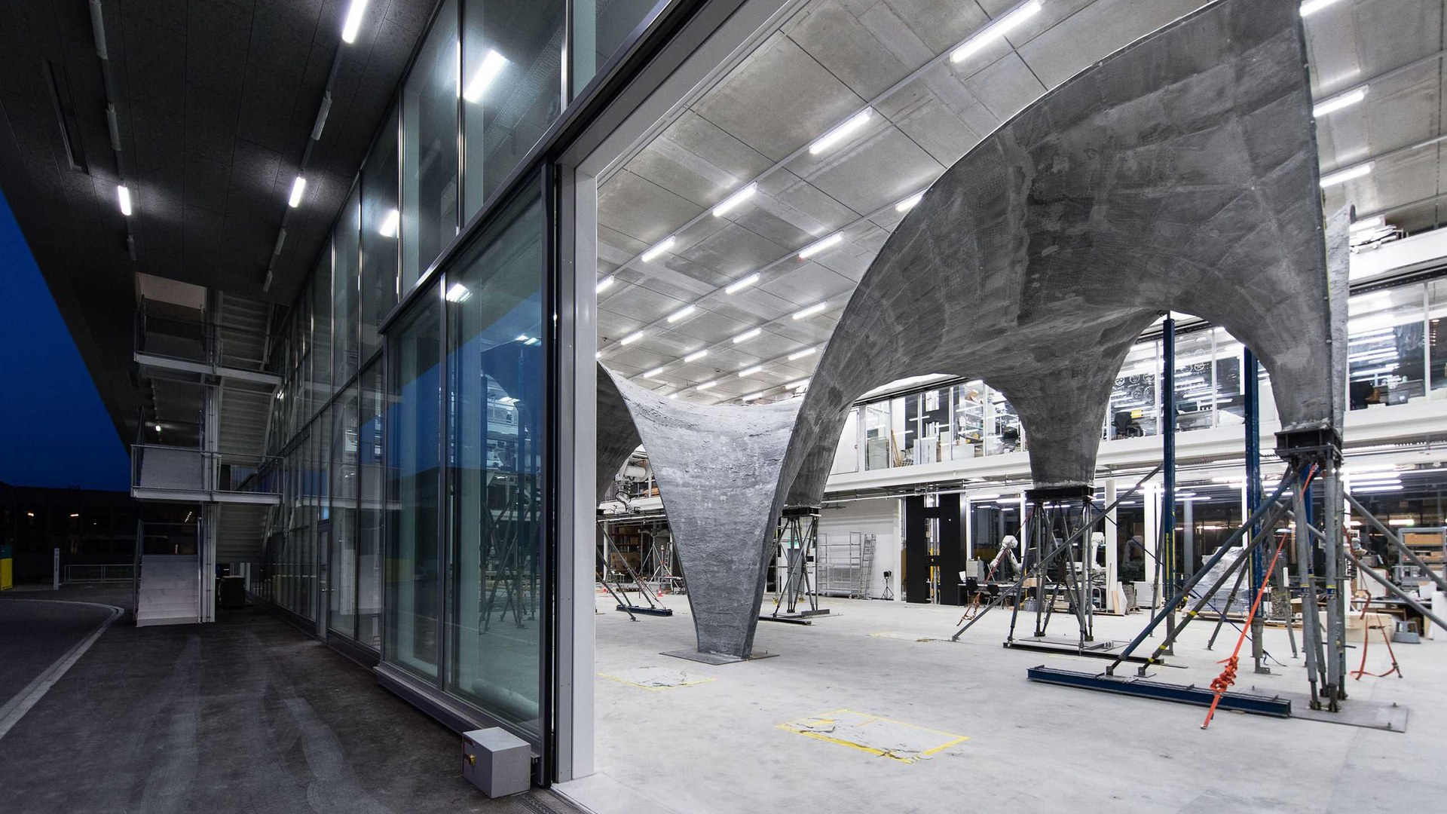
Block Research Group · ITA · D-ARCH · ETH Zürich
CAS
Computational Form-finding
10 ECTS
40 work days
3-12 months
300 h student work ≈ 100 h contact hours
Working draft
Notes:
Frame the ask: a concept for discussion, re-scoped from the prepared MAS, built on material the group already maintains. Ten ECTS, six chapters, first cohort October 2027.

Slide 2
Contents
Ch 1 History of Computational Structural Design
Ch 2 Computational Structural Design with COMPAS
Ch 3 Graphic Statics
Ch 4 Form Finding
Ch 5 Thrust Network Analysis
Ch 6 Materialization / Constructability
Ch 7 Individual Project
Notes:
This bar sits at the top of every chapter slide that follows, and it fills as we go. Segment widths are ECTS, so the picture also shows where the weight of the course sits: chapters 2 and the three method chapters.

Slide 3

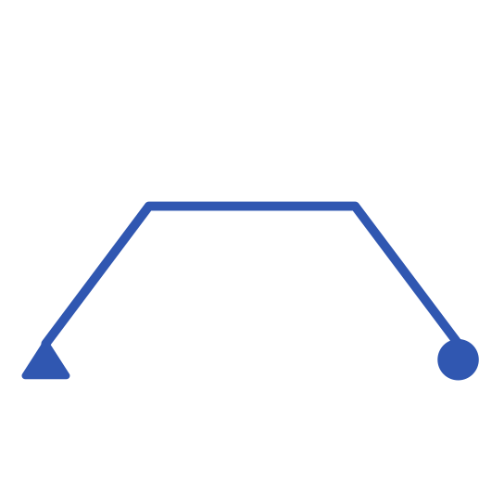
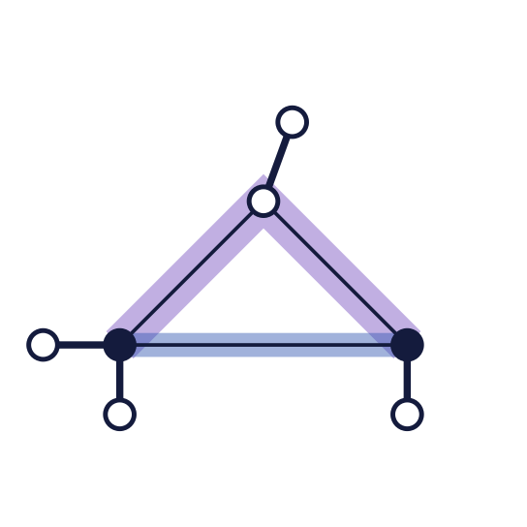



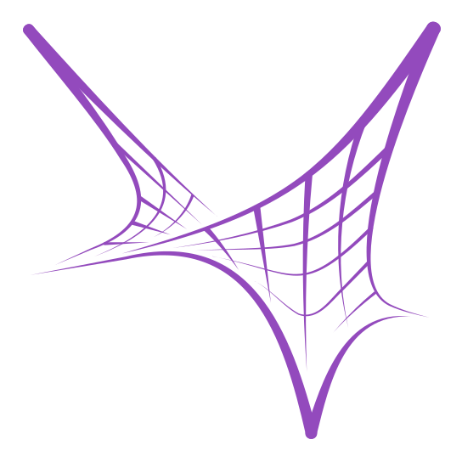
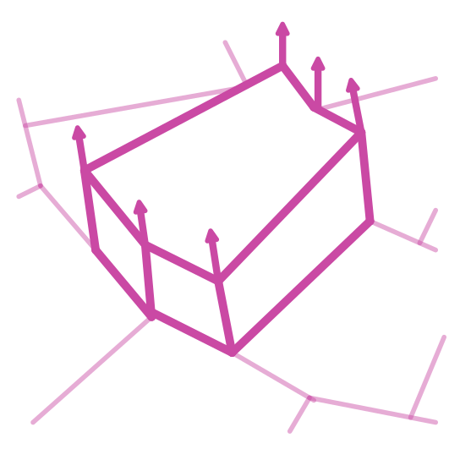
Course map
Chapter 1
Chapter 3
Chapter 5
Chapter 7
History of
Computational
Structural Design
Graphic Statics
Thrust Network
Analysis
Individual Project
Chapter 2
Chapter 4
Chapter 6
Computational
Structural Design
Form Finding
Materialization /
Constructability
Notes:
The seven chapters as one connected sequence, each represented by its key scheme.

Slide 4
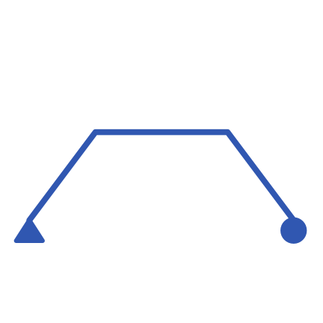

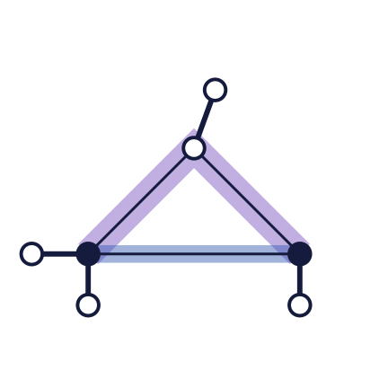
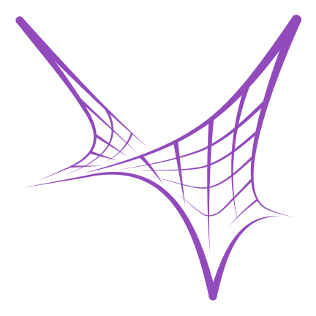



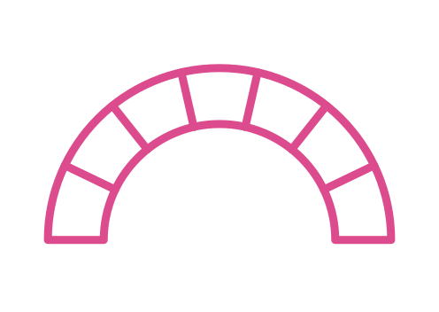





Course timeline
Teaching
History of
Computational
Structural Design
Computational
Structural Design
Graphic Statics
Form Finding
Thrust Network
Analysis
Materialization /
Constructability
Weeks 1–2
Weeks 3–4
Weeks 5–6
Weeks 7–8
Weeks 9–10
Weeks 11–12
Weeks 13–14
Weeks 15–16
Research
question
Physical
prototype
Midterm
review
Toolchain
Documented
project
Final review
Personal work
Notes:
Chapters 1 to 6 run one after another. The individual project runs underneath for the whole course; its six steps are placed where they fall in time, with the midterm review halfway.

Slide 5
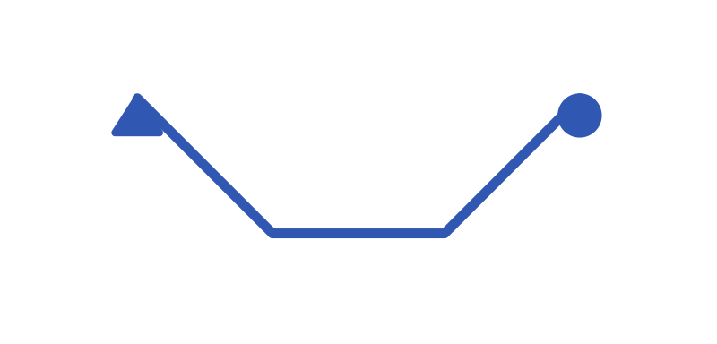
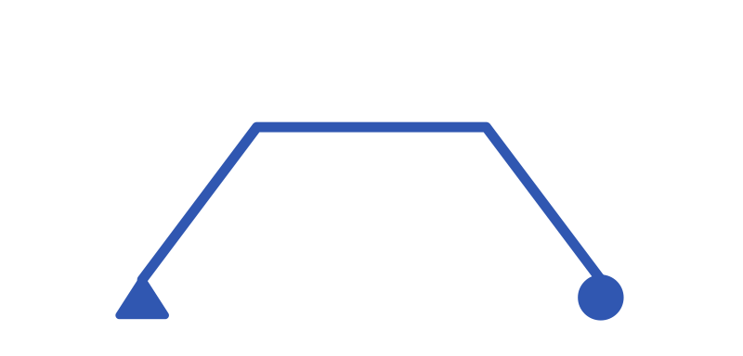
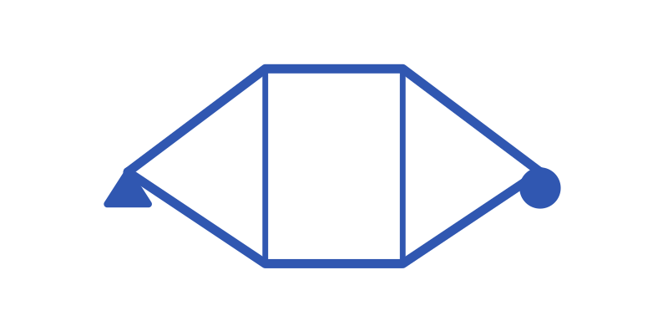
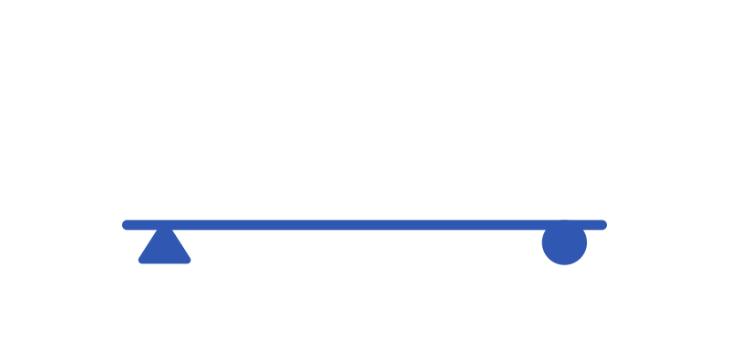
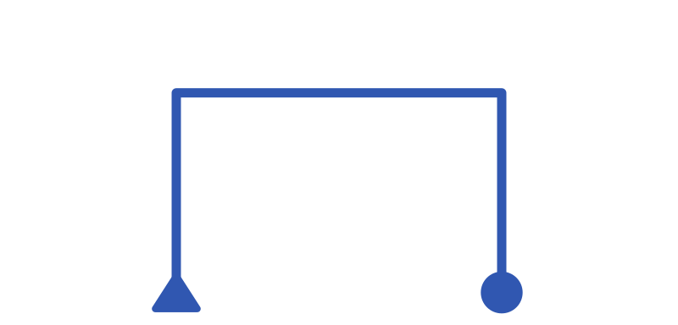
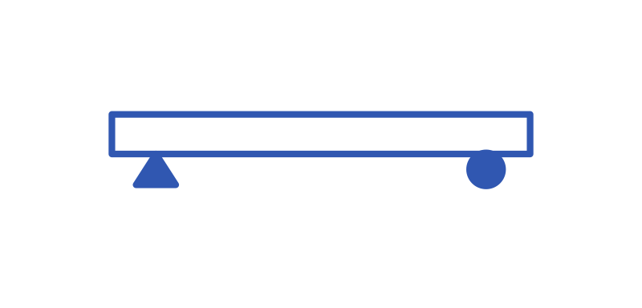

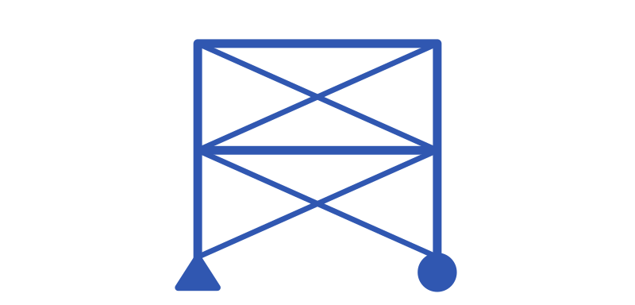
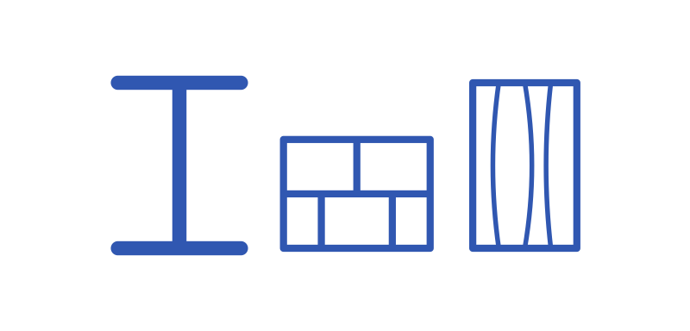
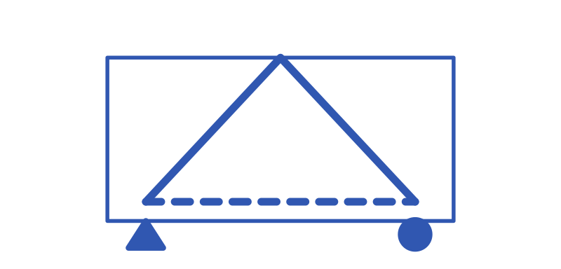
Chapter 1 · 1 ECTS · 30 h
History of Computational Structural Design
Introduction
Tutorials
Exercises
Cables
Arches
Trusses
Beams
Frames
Plates and slabs
Columns
Bracing
Material-specific forms
Plastic and stress-field
models
Notes:
Chapter 1 covers the history of computational structural design, and it starts from graphic statics fundamentals, the lectures shows various system as a global overview and also show graphic statics diagrams. At this moment no computation methods are taught.

Slide 6
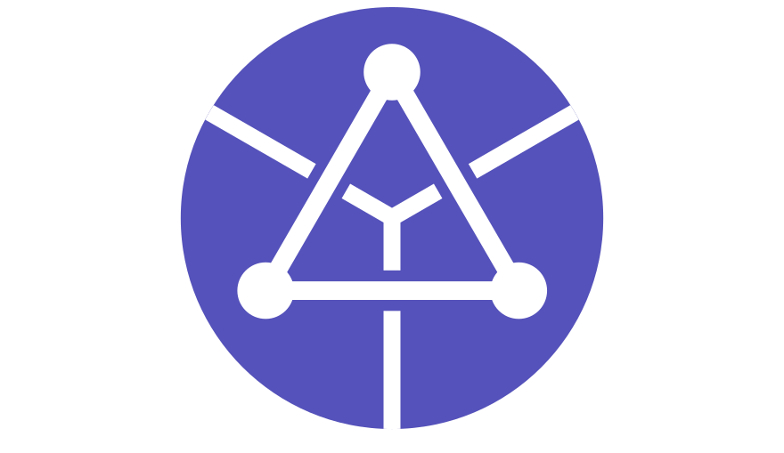

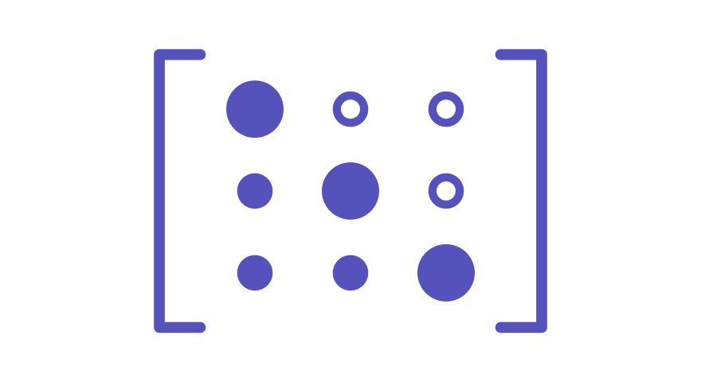

Chapter 2 · 1 ECTS · 30 h
Computational Structural Design
Introduction
Tutorials
Exercises
COMPAS
AEC Formats
Solvers
AI Connectors
Primitives
IFC
Matrix Decomposition
LLM
Data
Model
Optimization Solvers
Agents
Data Exchange
MCP
Geometry
Skills
Data Structures
Notes:
Chapter 2 introduces the computational toolkit: COMPAS, AEC exchange formats, solvers and AI connectors.

Slide 7
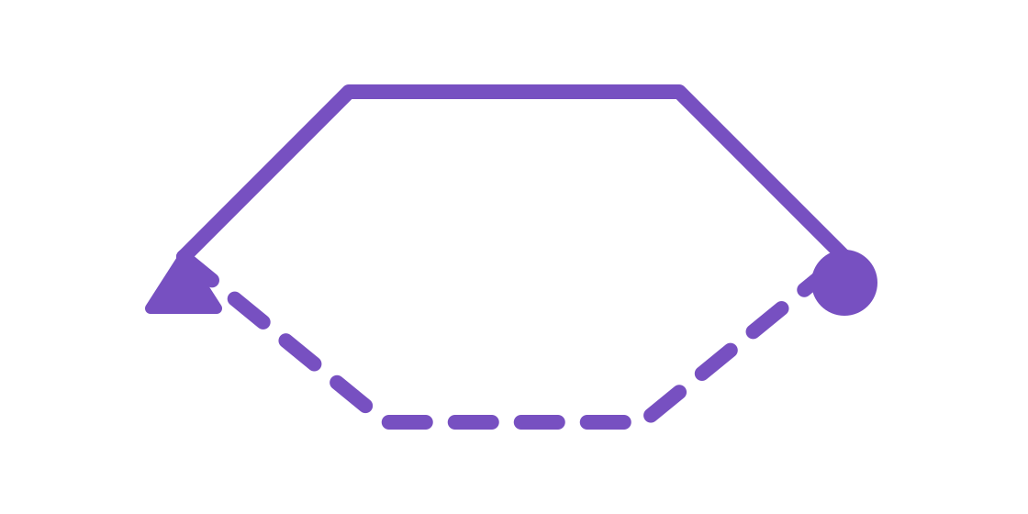
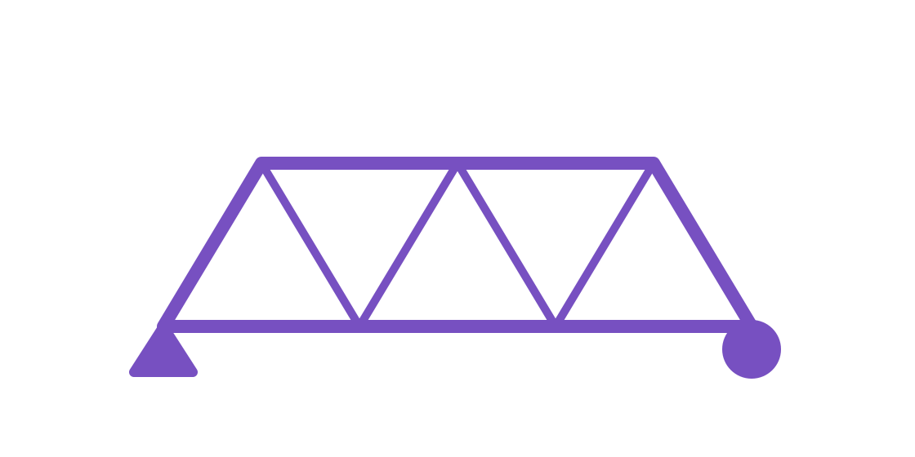
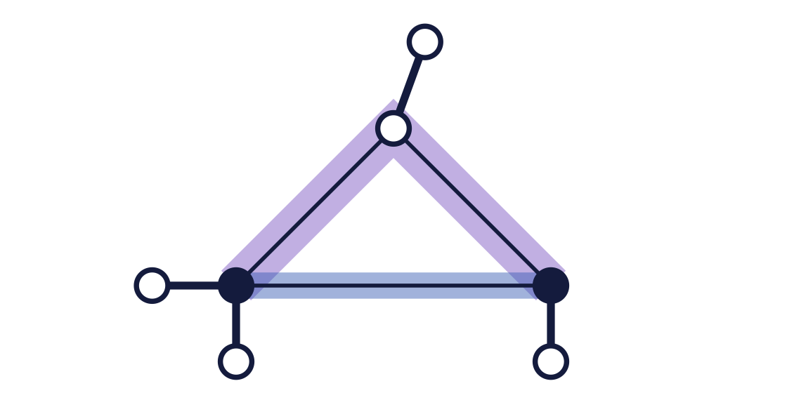
Chapter 3 · 1 ECTS · 30 h
Graphic Statics
Introduction
Tutorials
Exercises
Cables and arches
Trusses
compas_ags
Notes:
Chapter 3 moves from cables and arches to trusses, and then to trusses computed with compas_ags.

Slide 8

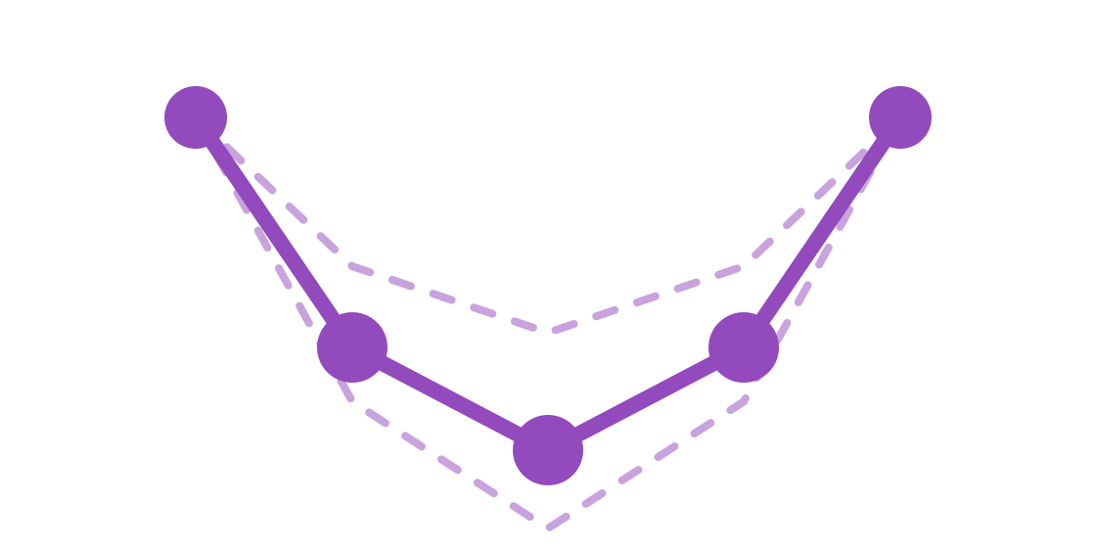
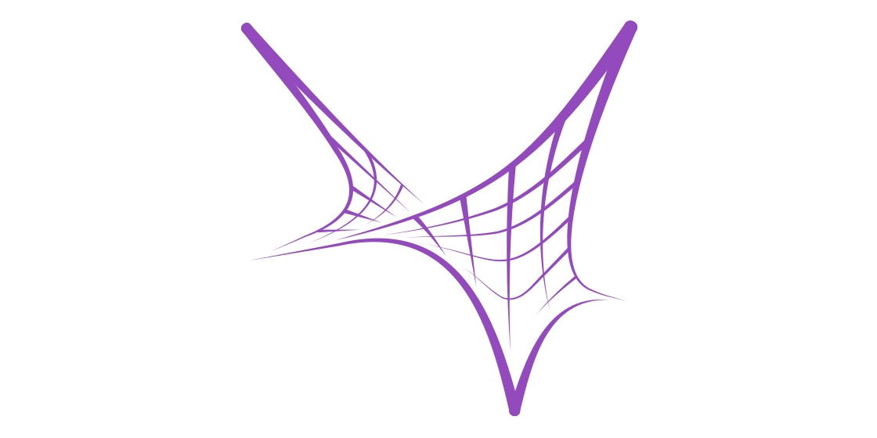
Chapter 4 · 1 ECTS · 30 h
Form Finding
Introduction
Tutorials
Exercises
Force density
Dynamic relaxation
Form finding
Notes:
Chapter 4 covers form finding through two methods: force density and dynamic relaxation.

Slide 9

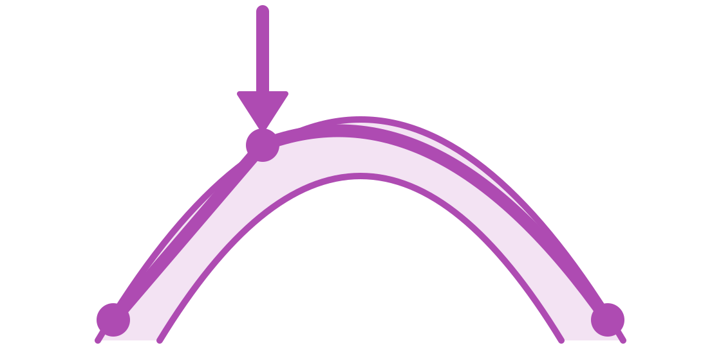
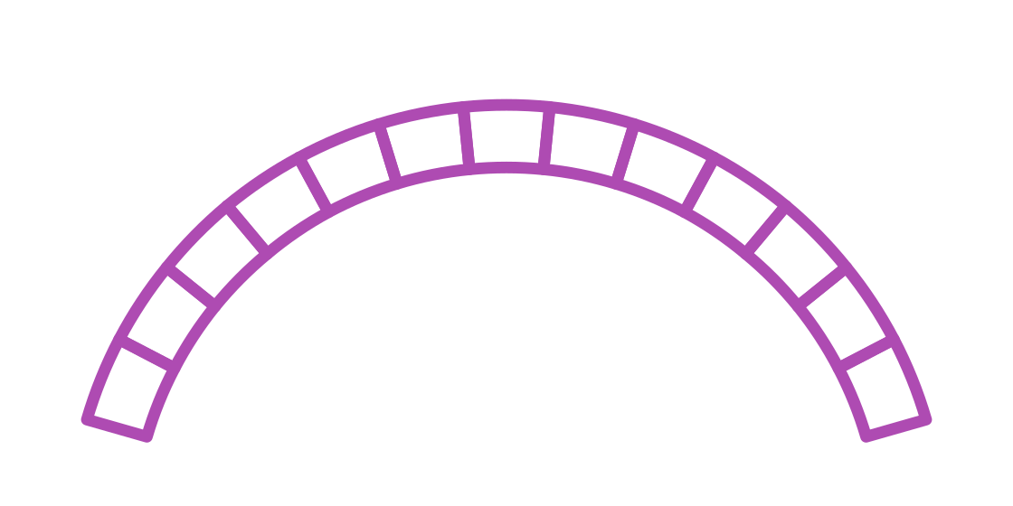
Chapter 5 · 1 ECTS · 30 h
Thrust Network Analysis
Introduction
Tutorials
Exercises
Thrust Network Analysis
Thrust Network Optimization
Discrete Element Modelling
Notes:
Chapter 5 covers thrust network analysis, thrust network optimization and discrete element modelling.

Slide 10
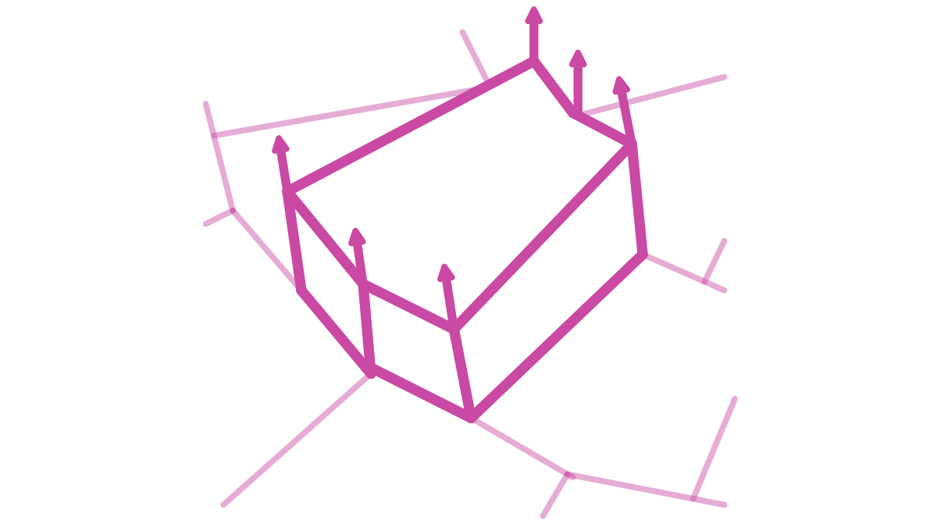
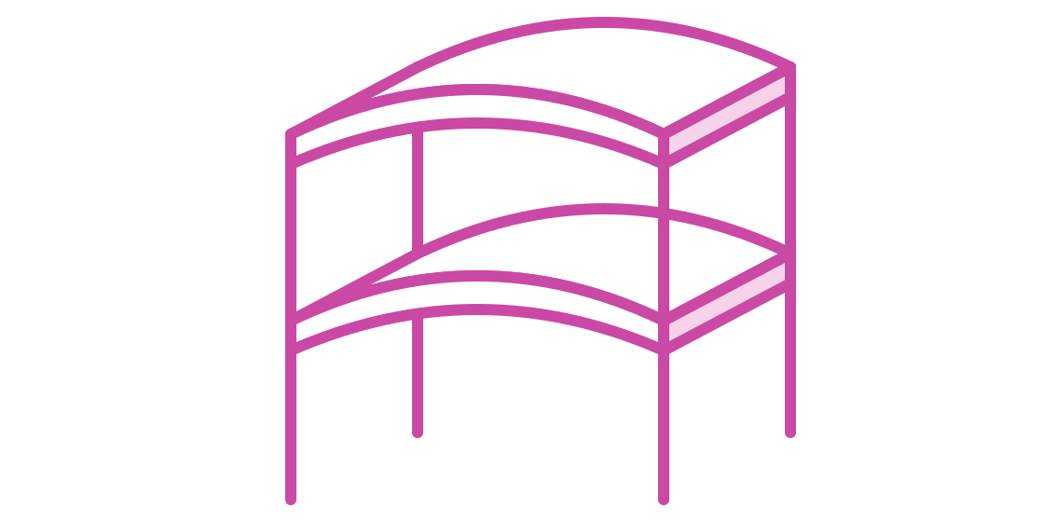

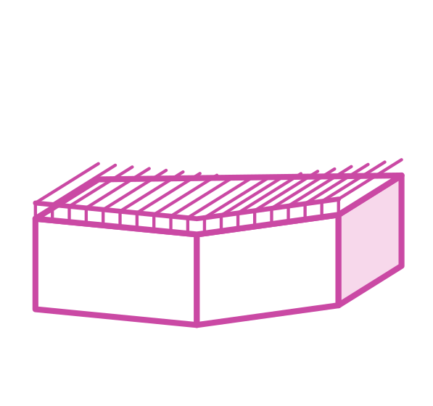

Chapter 6 · 1 ECTS · 30 h
Materialization / Constructability
Introduction
Tutorials
Exercises
Materialization
Model
Interactions
Notes:
Chapter 6 covers materialization and constructability: building models with compas_model and fabrication through 3D printing.

Slide 11

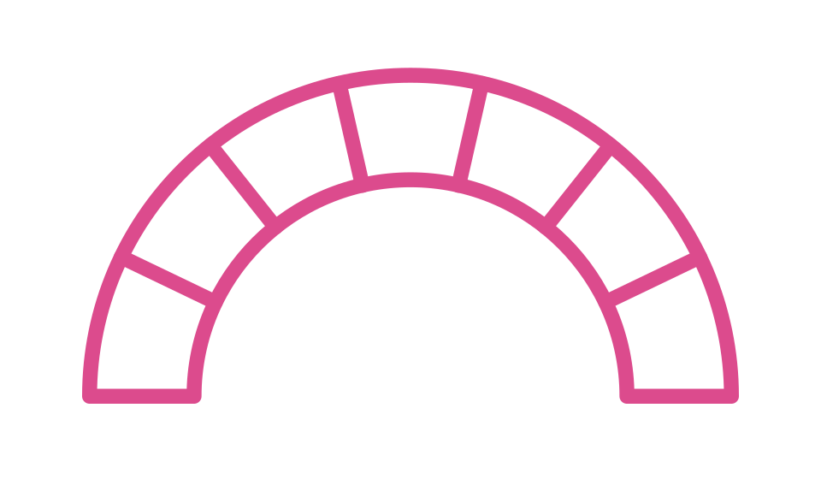





Chapter 7 · 4 ECTS · 120 h · runs across the full course
Individual Project
Introduction
Tutorials
Exercises
01
02
03
04
05
06
Research question
Physical prototype
Midterm review
Toolchain
Documented
project
Final review
Structural system
+ sustainability
Presentation
to an audience
At least two tools from
the previous chapters
Presentation
to an audience
In a GitHub repository
Notes:
The individual project in six steps: research question, physical prototype, toolchain, documented repository, midterm review and final review.

Slide 12
Notes:
Frame the ask: a concept for discussion, re-scoped from the prepared MAS, built on material the group already maintains. Ten ECTS, six chapters, first cohort October 2027.

Slide 13
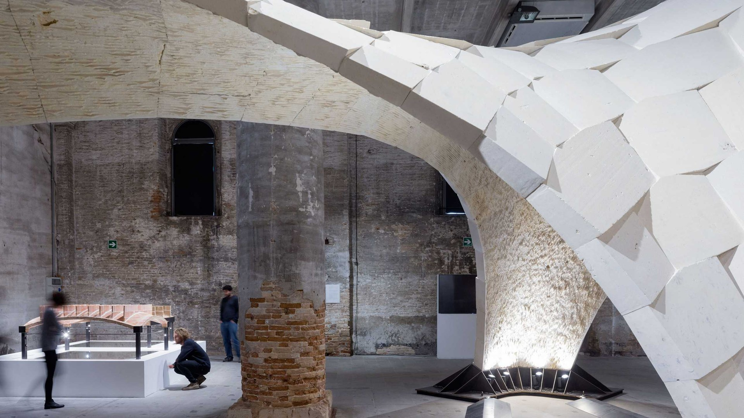
Chapter 1 · 1 ECTS · 30 h
History of Computational Structural Design
Contents
Resources
Submission
Structural typologies, taught through
classic drawing techniques.
Interactive platform
Hand-drawn graphic-statics
exercises and calculations.
eQUILIBRIUM platform: drawings, courses,
exams
Equilibrium & graphic-statics fundamentals
Funicular constructions: cable through
2–3 points, parabola vs catenary
Cables: funicular lines, distributed loads,
prestress
Gitbook: Computational Graphic Statics
compas-IGS: graphic statics in Rhino
Masonry arch check: thrust line,
min/max thrust
Arches: thrust lines, masonry on spreading
supports
Course PDF archive: slides, exercises +
solutions
Truss member forces via force
diagram
Arch-cable hybrids; span vs cantilever
Trusses: Pratt/Howe, lenticular, constant-
force
Beam/frame internal forces
(superposition)
Beams & frames: internal forces,
superposition
Techniques: form/force diagrams, funicular
polygon, trial funiculars, dividing systems
Notes:
Chapter 1 is graphic statics proper, and eQUILIBRIUM belongs here: the platform and the drawings player are the historical material made operable. Students reproduce the classic constructions before they write a line of code.

Slide 14
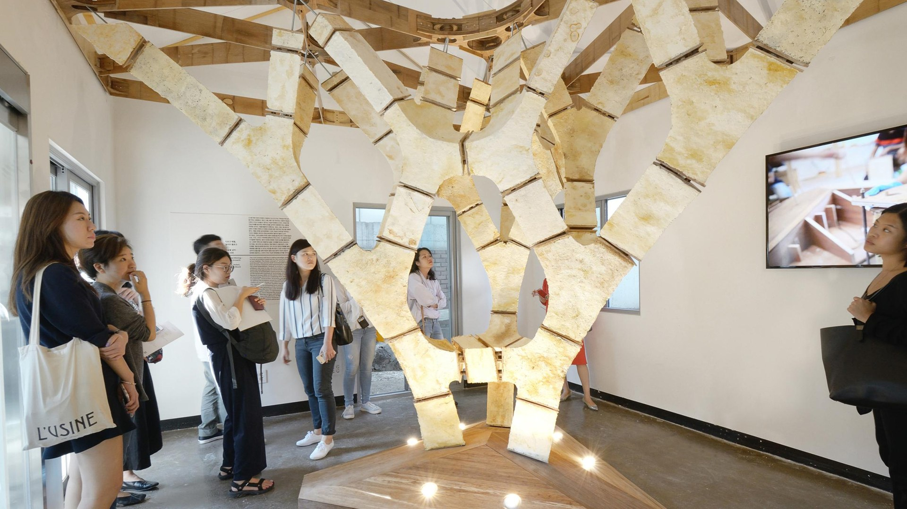
Chapter 1 · 1 ECTS · 30 h
Schedule: History of Computational Structural Design
Day 1
Day 2
Day 3
Day 4
Day 5
add activity
add activity
add activity
add activity
add activity
Notes:
Day-by-day plan for chapter 1. Four recurring activity types run through every chapter: hands-on work with physical models, the computational workflow, and integration into the individual work via LLMs.

Slide 15
Chapter 2 · 1 ECTS · 30 h
Computational Structural Design with COMPAS
Contents
Resources
Submission
Mathematical and geometrical
foundations, and why each one is
needed.
One course repo, one framework, one
installation guide.
The hand-drawn 2D topics, now
coded.
GKR course repo: lectures, assignments,
roadmap
Warm-ups: brick wall, point grid
Mathematical and geometrical foundations
Funicular line through 2–3 points
Math versus freeform geometrical
descriptions
compas.dev: getting started + API reference
Truss builder with member force data
Installation guide, this repo
Final project: one classic construction
as a parametric script
Algorithms: how a design intent becomes a
procedure
Python cheat sheet & reference
Book: Geometric Computation
Mesh with connectivity, and its matrices
Rhino Python guide / RhinoCommon API
Dot and cross products, and where they are
used
BRG-teaching workshops
Matrix decomposition inside solvers
Graphs: when to use one, and how it is
formulated
Optimisation solvers and automatic
differentiation
Notes:
The bootcamp. No prior Python required, which is the deliberate market-widening decision — week zero handles installation so day one is not lost to conda.

Slide 16
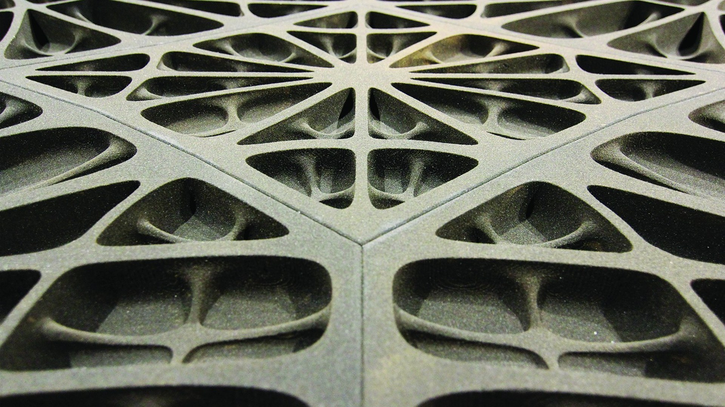
Chapter 2 · 1 ECTS · 30 h
Schedule: Computational Structural Design with COMPAS
Day 1
Day 2
Day 3
Day 4
Day 5
add activity
add activity
add activity
add activity
add activity
Notes:
Day-by-day plan for chapter 2. Four recurring activity types run through every chapter: hands-on work with physical models, the computational workflow, and integration into the individual work via LLMs.

Slide 17
Chapter 3 · 1 ECTS · 30 h
Graphic Statics
Contents
Resources
Submission
The hand constructions rebuilt as
code.
Packages, plugins and GitBooks.
Drawn by hand first, then
reproduced and verified in code.
compas_ags: algebraic graphic statics
Form and force diagrams, reciprocity in code
compas-IGS: graphic statics in Rhino
Three eQUILIBRIUM views re-
implemented as scripts
Equilibrium set up from graph data
Gitbook: Computational Graphic Statics
Forces and geometry modified, force
diagrams computed
eQUILIBRIUM views as starter code
An arch or truss sized for given loads
Strut-and-tie thinking for load paths
Notes:
This is where hand construction becomes code. The five-step table after Chapter 5 expands exactly this transition, so keep it brief here.

Slide 18
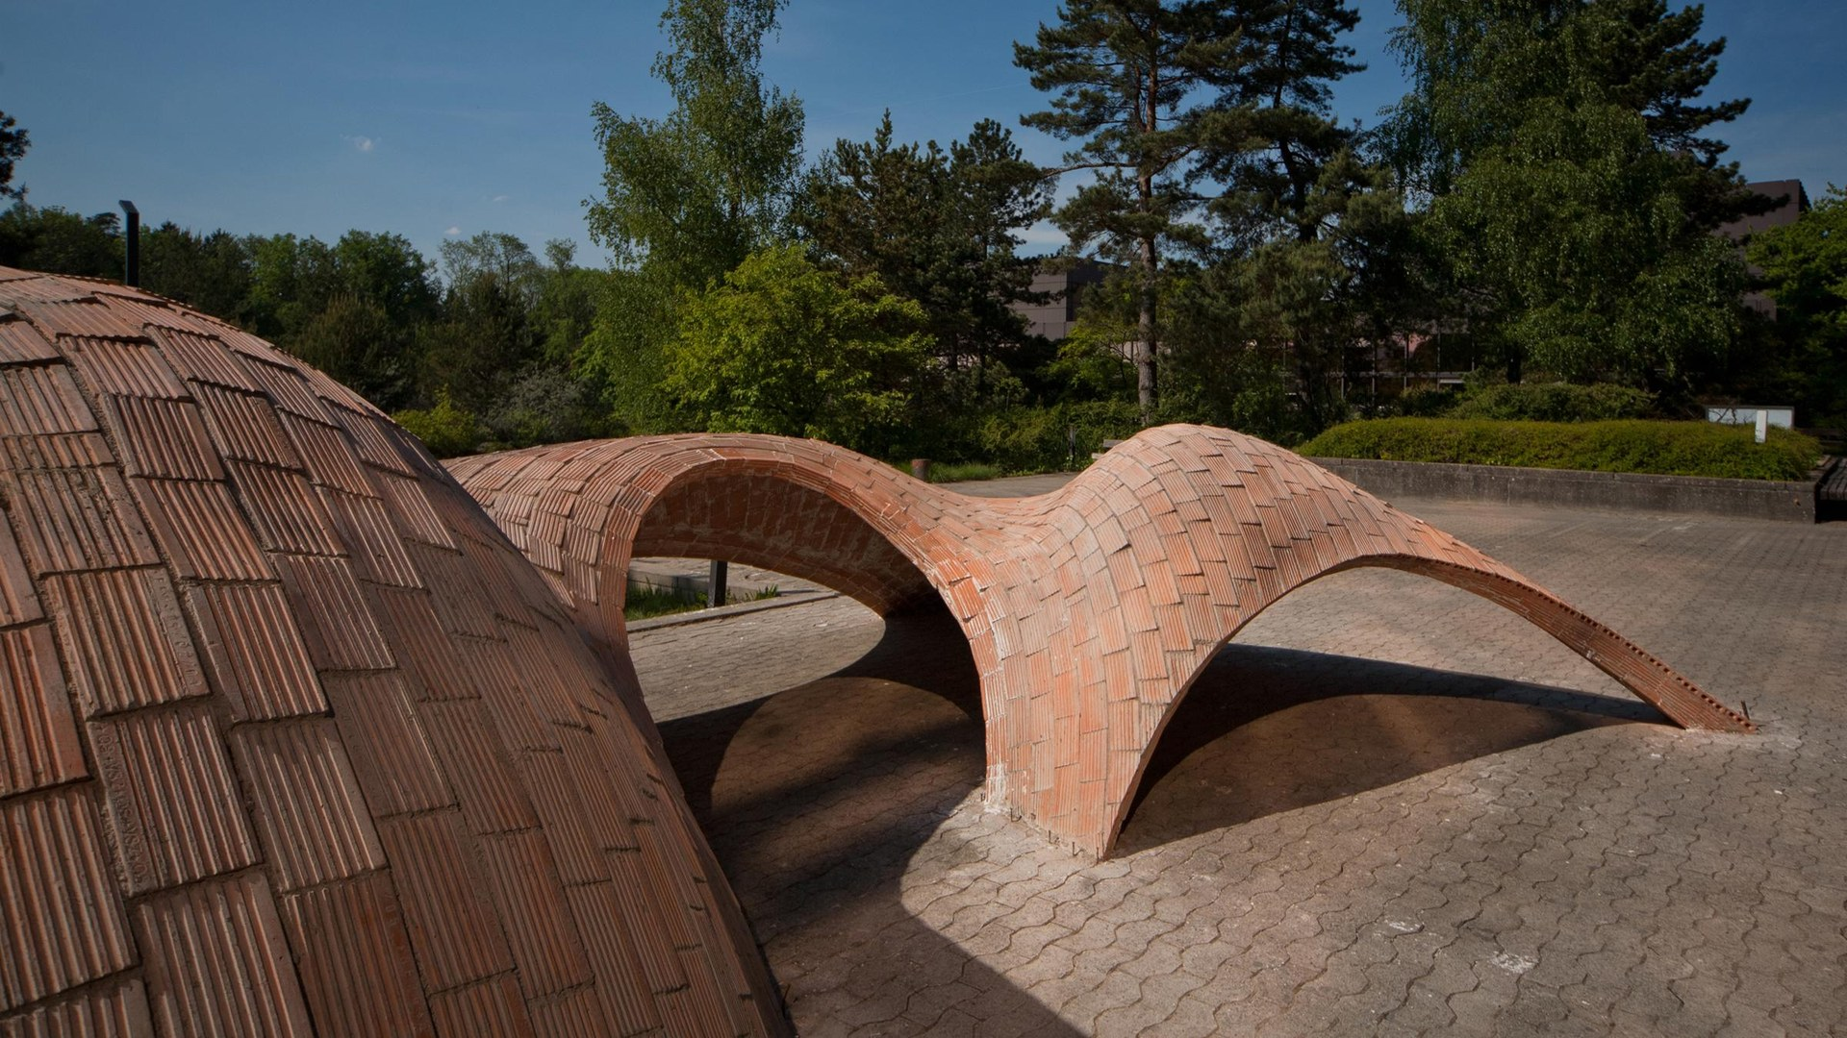
Chapter 3 · 1 ECTS · 30 h
Schedule: Graphic Statics
Day 1
Day 2
Day 3
Day 4
Day 5
add activity
add activity
add activity
add activity
add activity
Notes:
Day-by-day plan for chapter 3. Four recurring activity types run through every chapter: hands-on work with physical models, the computational workflow, and integration into the individual work via LLMs.

Slide 19
Chapter 4 · 1 ECTS · 30 h
Form Finding
Contents
Resources
Submission
Nets and membranes.
Packages, plugins and GitBooks.
A form-found tension structure,
with the solver choice justified.
Force density method, Schek 1974: force-
length ratios
compas_fd: force density
compas_dr: dynamic relaxation
A saddle net and a cable-net canopy
Boundary conditions and constraints
compas-FoFin: FormFinder in Rhino
FD and DR compared on the same
problem
Dynamic relaxation with kinetic damping
Gitbook: COMPAS FormFinder
When to use which solver
BRG demonstrator case material:
KnitCandela, HiLo.
Equilibrium verified in code, in a
notebook
Tensile surfaces and cable-net formworks
Notes:
Chapter 4 is the largest solver chapter and rests on the most mature gitbook. It is also where the missing mathematics hurts most: students meet two solvers and have to choose between them.

Slide 20
Chapter 4 · 1 ECTS · 30 h
Schedule: Form Finding
Day 1
Day 2
Day 3
Day 4
Day 5
add activity
add activity
add activity
add activity
add activity
Notes:
Day-by-day plan for chapter 4. Four recurring activity types run through every chapter: hands-on work with physical models, the computational workflow, and integration into the individual work via LLMs.

Slide 21
Chapter 5 · 1 ECTS · 30 h
Thrust Network Analysis
Contents
Resources
Submission
From thrust network to buildable
vault.
Packages, plugins and Gitbooks.
A compression-only structure,
checked for stability and
buildability.
compas_tna: thrust network analysis
Thrust networks: horizontal equilibrium of
the form diagram
compas_tno: optimisation of thrust networks
compas_dem: discrete element modelling
A vault form-found from a given plan
Vertical equilibrium and force densities
compas-RV / RhinoVAULT in Rhino 8
The form diagram steered iteratively
Relation to graphic statics: reciprocity in 3D
Gitbook: RhinoVAULT
A pavilion verified with compas_tna,
documented
Funicular shells and masonry vaults: stability,
load cases
Study cases: Armadillo Vault, Striatus Bridge
Interactive form-finding with RhinoVAULT
Scripted workflows with compas_tna,
optimisation with compas_tno
Boundaries, openings, thickness,
materialisation
Notes:
Chapter 5 closes the loop back to Chapter 1: TNA is reciprocity in three dimensions. RhinoVAULT gives the interface, compas_tna the script, compas_tno the outlook to optimisation.

Slide 22
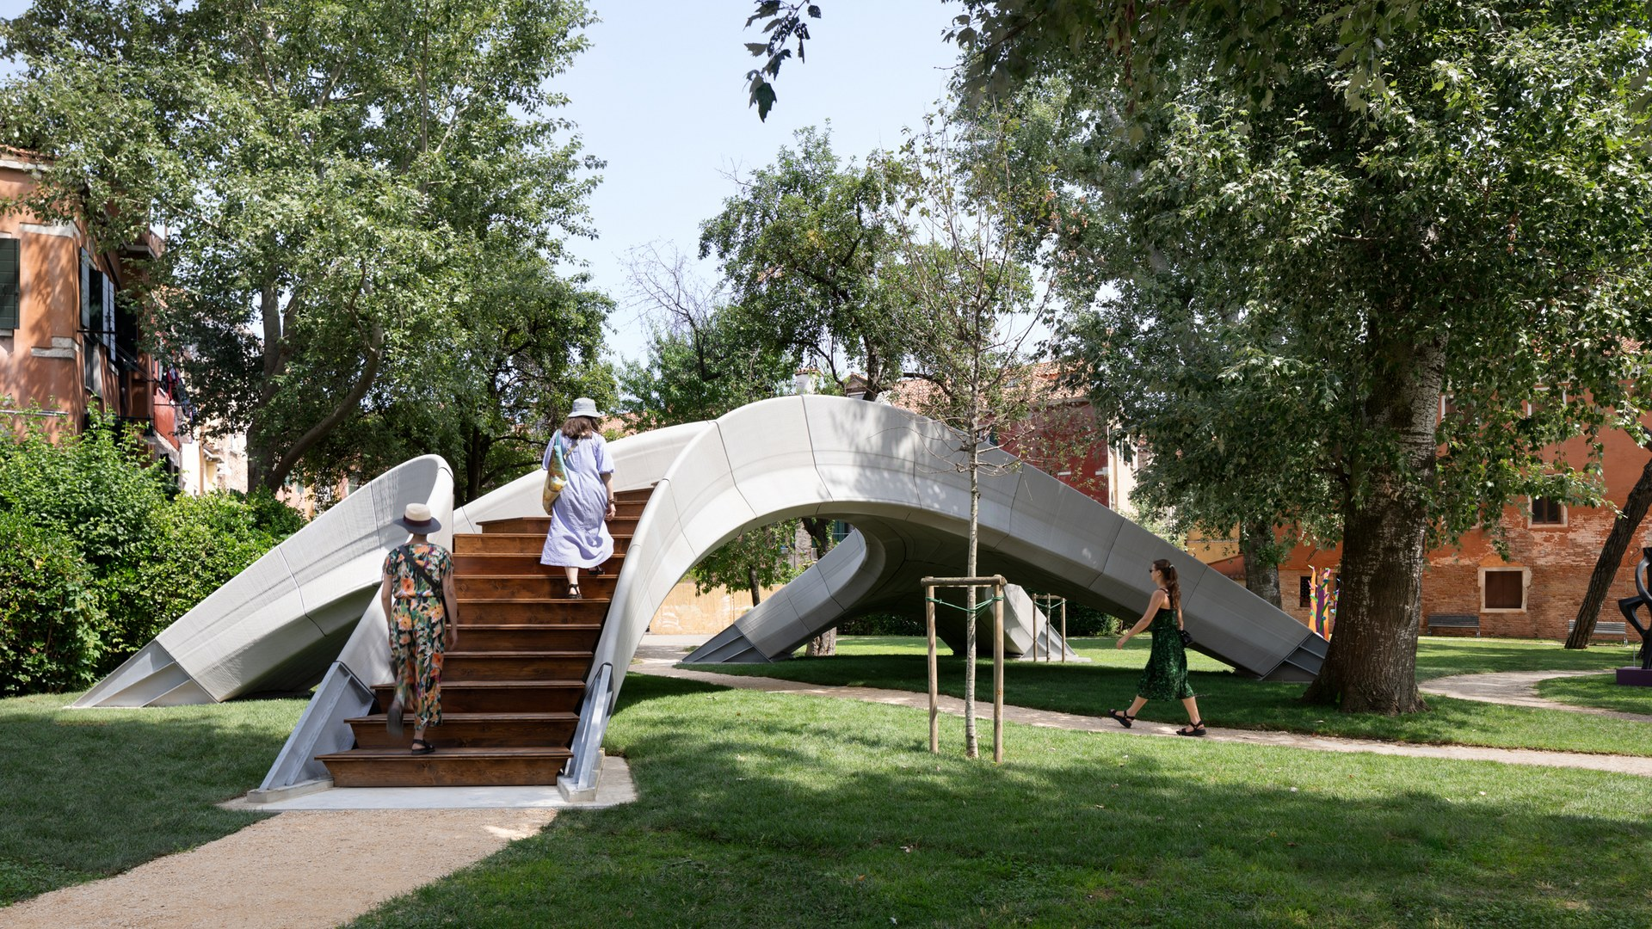
Chapter 5 · 1 ECTS · 30 h
Schedule: Thrust Network Analysis
Day 1
Day 2
Day 3
Day 4
Day 5
add activity
add activity
add activity
add activity
add activity
Notes:
Day-by-day plan for chapter 5. Four recurring activity types run through every chapter: hands-on work with physical models, the computational workflow, and integration into the individual work via LLMs.

Slide 23
Chapter 6 · 1 ECTS · 30 h
Materialization / Constructability
Contents
Resources
Submission
From form-found geometry to
something that can be built.
Discrete element packages and the
fabrication lab.
A buildable version of the form
found in Ch 3 to 5.
Discretisation: from surface to blocks and
panels
compas_model: model organisation
Discretised geometry with interfaces
resolved
Robotic Fabrication Laboratory (RFL)
Interfaces, joints and contact surfaces
Study cases: Striatus, Phoenix, Armadillo
Vault
Assembly drawings and sequence
Tolerance, fabrication constraints, material
limits
Stability check of the partially built
state
Assembly sequence, stability during
construction
A small physical model of the
assembly
Formwork and falsework strategies
Robotic fabrication and digital workflows
Notes:
The chapter that turns a form-found geometry into something buildable: discretisation, interfaces, tolerance, assembly sequence, and fabrication at the RFL.

Slide 24
Chapter 6 · 1 ECTS · 30 h
Schedule: Materialization / Constructability
Day 1
Day 2
Day 3
Day 4
Day 5
add activity
add activity
add activity
add activity
add activity
Notes:
Day-by-day plan for chapter 6. Four recurring activity types run through every chapter: hands-on work with physical models, the computational workflow, and integration into the individual work via LLMs.

Slide 25
Chapter 7 · 4 ECTS · 120 h · runs across the full course
Individual Project
Own design question: arch, vault, shell, cable net or strut-and-tie
Resources
At least two toolchains, running as code
Proposal · mid-term peer review · final review with external critics
The Robotic Fabrication Laboratory.
A physical prototype of the form-found design
RFL, Arch_Tec_Lab building, Hönggerberg campus
Public repository · 4–6 page booklet · 15-minute defence
Four six-axis robots on an overhead gantry, working
cooperatively
Maximum working volume 43 × 16 × 8 m
Open across disciplines, for full-scale design and construction
experiments
What each chapter submits
Ch 1 · ungraded
Ch 2 · 10 %
Ch 3 · 10 %
Ch 4 · 10 %
Ch 5 · 5 %
Ch 6 · 5 %
Ch 7 · 60 %
Annotated
constructions,
one essay
Notebooks, truss
module
Three views in
code
Net and canopy,
FD vs DR
Vault and pavilion
Assembly
drawings, physical
model
Repository,
booklet, physical
prototype,
defence
Notes:
Everything accumulates here: sixty per cent of the grade, two toolchains minimum, and it has to run as code. This is also what graduates take away — a public repository with their name on it.

Slide 26
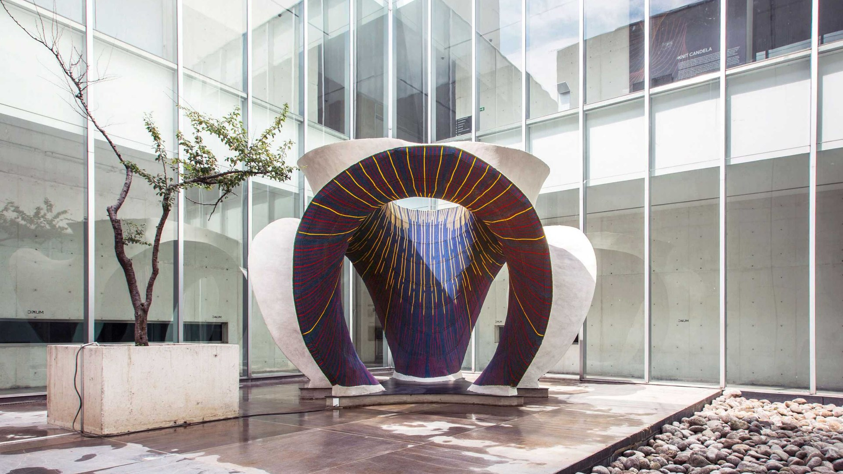
Chapter 7 · 4 ECTS · 120 h · runs across the full course
Schedule: Individual Project
Day 1
Day 2
Day 3
Day 4
add activity
add activity
add activity
add activity
Day 5
Day 6
Day 7
Day 8
add activity
add activity
add activity
add activity
Notes:
Day-by-day plan for chapter 7. Four recurring activity types run through every chapter: hands-on work with physical models, the computational workflow, and integration into the individual work via LLMs.

Slide 27
Graphic Static Solvers
Ch 1
Ch 1
Ch 3
Ch 4
Ch 5
By hand
Precomputed
Algebraic
Iterative
Constrained, 3D
Ruler and compass
eQUILIBRIUM
compas_ags · IGS
compas_fd ·
compas_dr
compas_tna ·
RhinoVAULT
Equilibrium by
Closing the force
polygon
Fixed constraints
Linear system
Iteration to a
residual
Horizontal, then
vertical
Designer controls
Every line
Loads and positions
Form or force
diagram
Supports and force
densities
Topology and
thickness
Teaching gap
None
Teaching material
Graded exercises
Solver maths
Solver maths
From the repo ReadMe
“2D Graphic Statics is made for teaching. Everything else is made for developers.”
Notes:
Read across: the same equilibrium problem, five ways of defining and enforcing it. This is the spine of the whole curriculum — students draw it before they solve it, and solve it before they constrain it.

Slide 28
What Still Needs to Be Done
What the repo says about itself
01
Merge the graphic statics gitbooks into one course
book
3–4 w
“2D Graphic Statics is made for teaching.”
“Everything else is made for developers.”
02
Write the maths behind the solvers
4–6 w
“Why math is not explained how the solvers work, as the focus is
given to the user interfaces?”
03
Write exercises and notebooks for Ch 3 to 5, with
answers
6–8 w
“FEA resources very minimal.” · “AI materials is absent.” Both are
deferred to a CAS 2, together with masonry and BIM.
04
Write the project briefs and how they are marked
2 w
05
Turn the built projects into case material we may
share
2–3 w
06
File the SCE papers, hire the coordinator, set up the
course website
3–4 w
Sep 2026
Nov 2026
2027
Oct 2027
About 20 to 30 weeks of writing
Content
Department says
yes
Rules and
marketing
First students
start
Most of it is rewriting what we already have.
Notes:
The repo names its own gaps; these six items answer them. Twenty to thirty person-weeks, mostly adapting existing research documentation. The ask today is approval to file the SCE package for the November DK.

